Slide 1
Guitar Gods Unleashed: The Legacy of Page, Fogerty, and Van Halen
Jimmy Page¹, John Fogerty² & Eddie Van Halen³
¹ Led Zeppelin, London (UK)
² Creedence Clearwater Revival, California (USA)
³ Van Halen, Amsterdam (The Netherlands)

Slide 2
Contents
Introduction
Materials and Methods
Results
Discussion
Conclusion
Acknowledgements

Slide 3
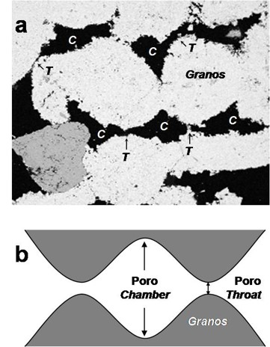
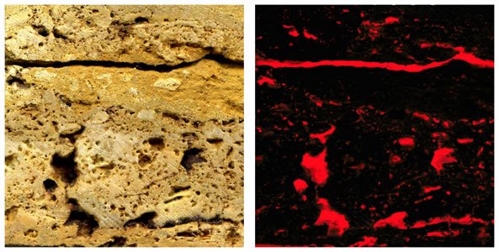
1. Introduction
Source: https://eurock2024.com/workshops

Slide 4
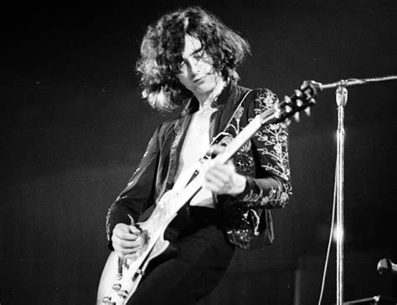
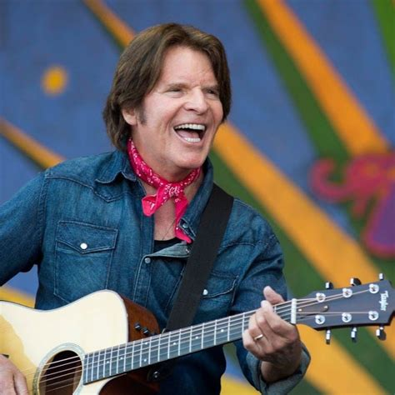
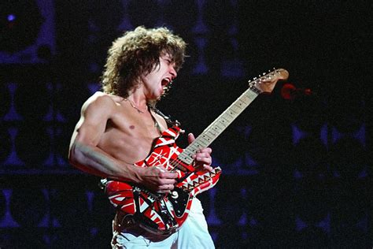
1. Introduction
Jimmy Page, John Fogerty, and Eddie Van Halen are iconic figures in the world of rock music. Each has left an indelible mark on the industry through their talent, creativity, and influence.
Source: Bing

Slide 5
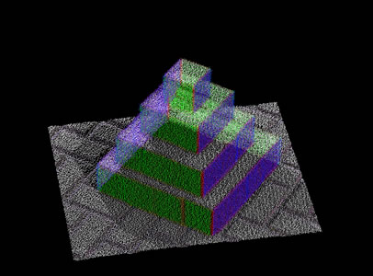

2. Materials and methods
Source: https://eurock2024.com/workshops

Slide 6
2. Materials and methods
Let’s explore the musical backgrounds, styles, and significant contributions of these legendary guitarists.
We’ll delve into their early careers, influences, and the instruments they used to shape rock history.

Slide 7
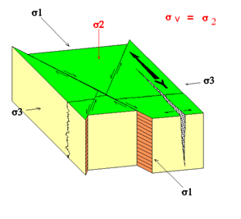
3. Results
In this section, we’ll highlight key achievements and milestones for each artist.
From Jimmy Page’s groundbreaking work with Led Zeppelin to John Fogerty’s timeless hits with Creedence Clearwater Revival, we’ll celebrate their impact.
Source: https://eurock2024.com/workshops

Slide 8
3. Results
Table. A comparison of the two best songs by Jimmy Page, John Fogerty, and Van Halen
Artist | Best Songs
Jimmy Page | Stairway to Heaven
 | Whole Lotta Love
John Fogerty | Fortunate Son
 | Proud Mary
Van Halen | Jump
 | Panama

Slide 9
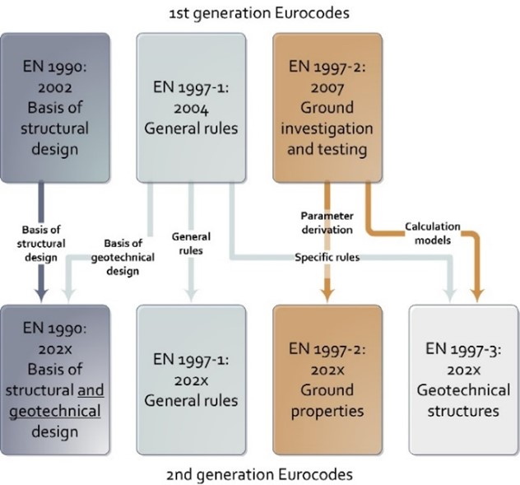
4. Discussion
Source: https://eurock2024.com/workshops

Slide 10
4. Discussion
Here, we’ll analyze their musical techniques, songwriting approaches, and the impact of their compositions.
We’ll discuss their influence on subsequent generations of musicians and their enduring legacy.

Slide 11
5. Conclusion
Our journey through the lives of Jimmy Page, John Fogerty, and Eddie Van Halen will culminate in a reflection on their lasting contributions.
We’ll consider how their artistry continues to resonate with fans worldwide.

Slide 12
Acknowledgements
We acknowledge the immense influence of these three guitar virtuosos and express gratitude for their enduring musical legacy.
Feel free to customize and expand upon these sections as needed. 🎸

Slide 13





Acknowledgements

Slide 14
Guitar Gods Unleashed: The Legacy of Page, Fogerty, and Van Halen
Jimmy Page¹, John Fogerty² & Eddie Van Halen³
¹ Led Zeppelin, London (UK)
² Creedence Clearwater Revival, California (USA)
³ Van Halen, Amsterdam (The Netherlands)

